Slide 1

Bware
Buoy Water Analysis Reporting Environment
*still open to suggestions for a better acronym
Colin Baxter, Zac Espinosa, Ben Makhlouf, & Cole Morokhovich
Notes:
Title slide from Streamlit

Slide 2
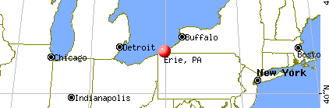
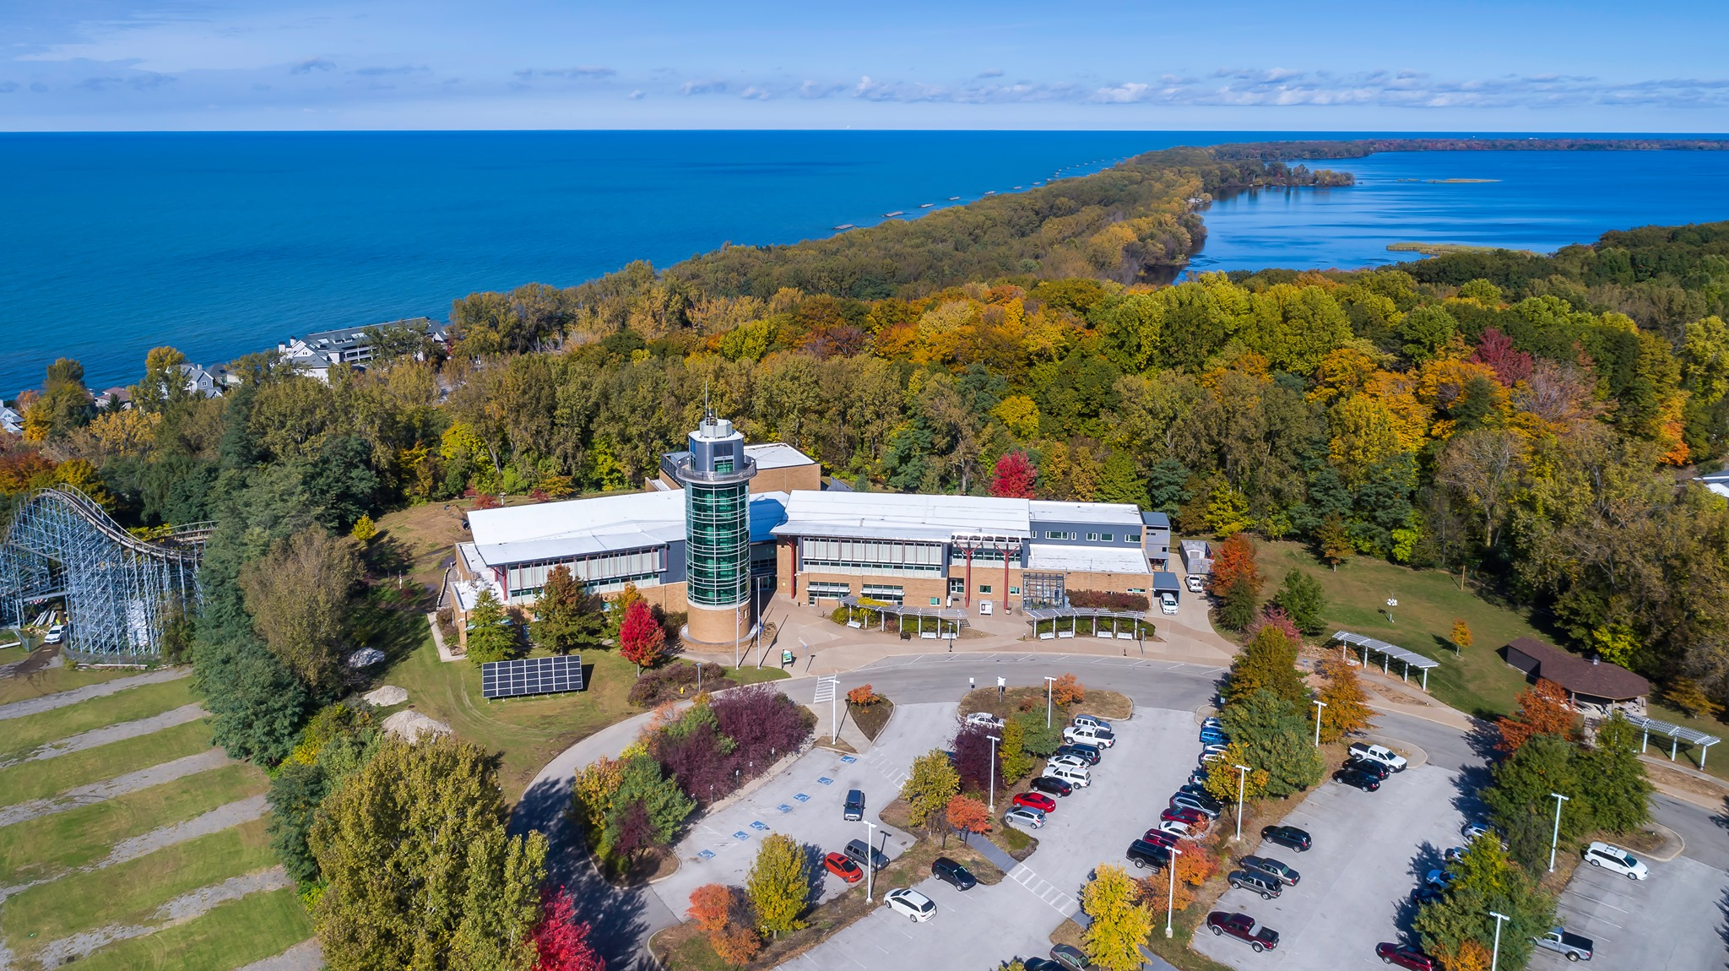
Background/Motivation: The Waters of Lake Erie
Our team worked with a non-profit research group in Erie, PA
Regional Science Consortium
501c(3) Non-Profit Org.
Facilitates
Education
Research
Collaboration
Lake Erie
T.R.E.C.
Notes:
TREC Photo: https://www.facebook.com/photo/?fbid=479296514202239&set=a.479296500868907
Erie Map: https://www.city-data.com/city/Erie-Pennsylvania.html

Slide 3
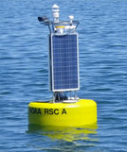
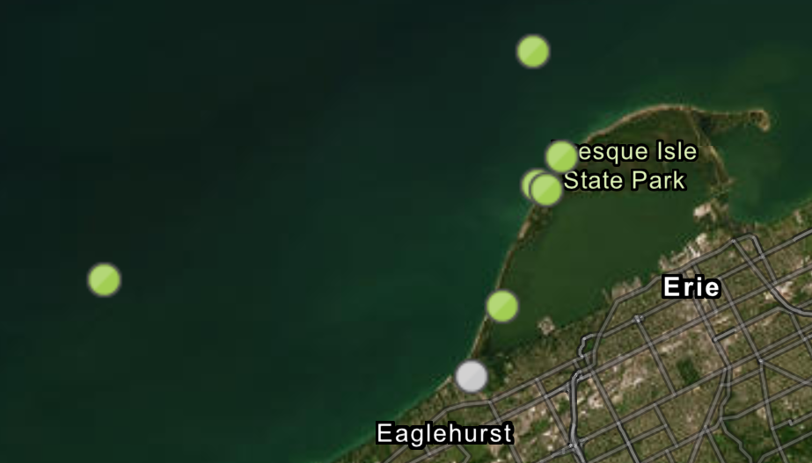
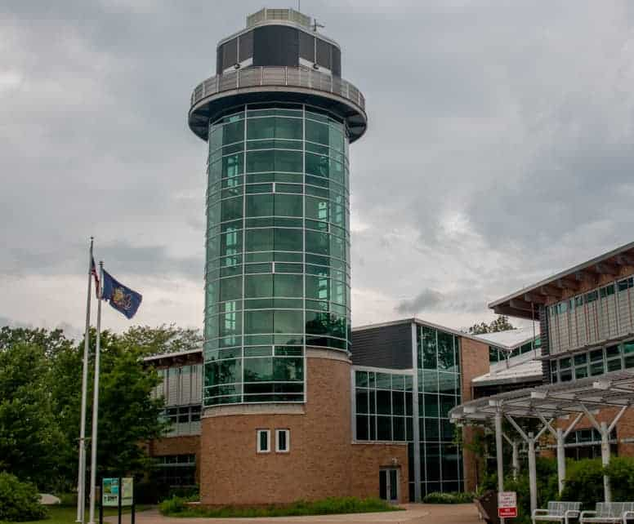
The RSC Operates and Maintains Buoys
The buoys collect data
Temperature, Wind Speed, etc
Accessed by many groups
Fishermen
Scientists
Beachgoers
Notes:
RSC Photos: https://www.regsciconsort.com/research/current-projects/nearshore-buoy-system/
TREC Tower: https://uncoveringpa.com/tom-ridge-environmental-center

Slide 4
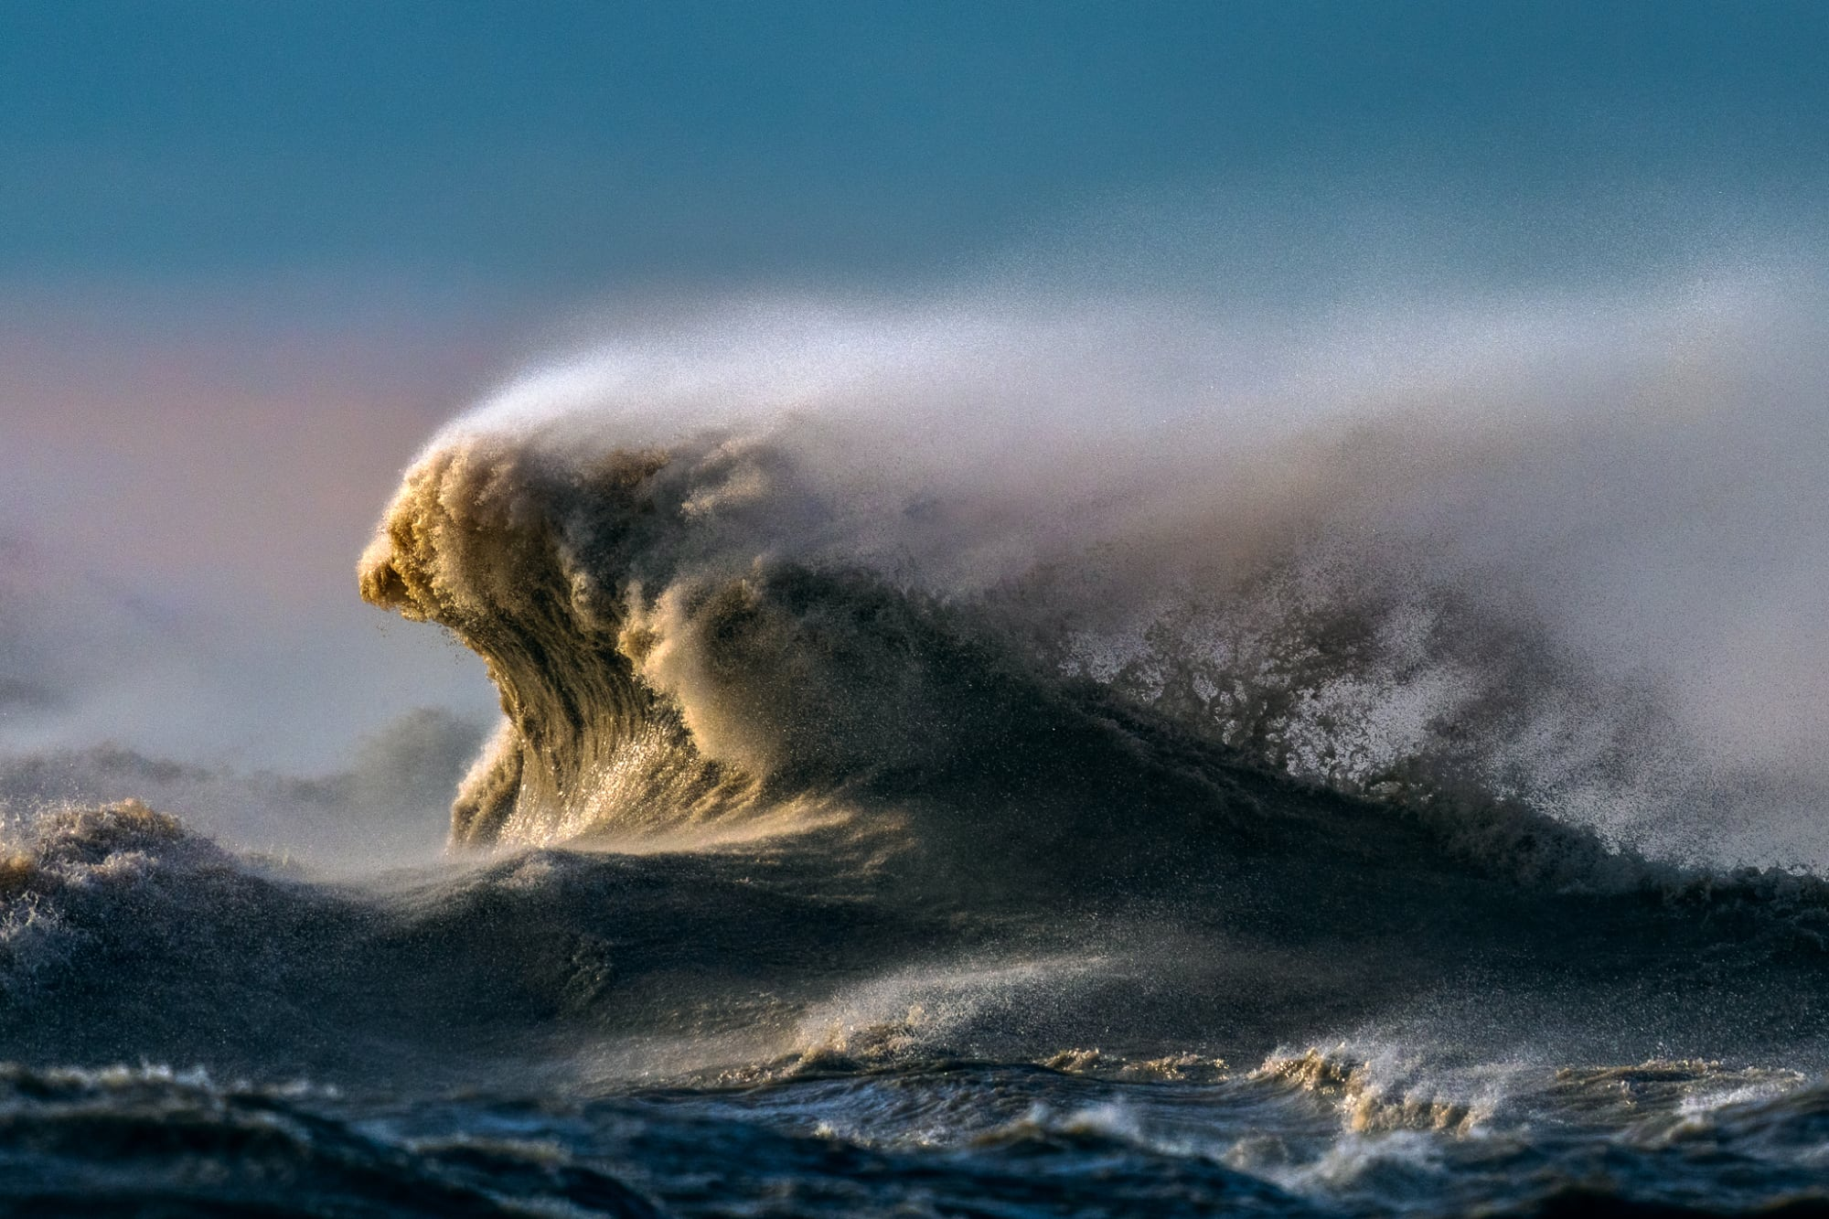
The Issue: There is a lot of data
Waves of data
Data contains outliers
Research requires years worth of data
Data is not uniform
Data will further accumulate over time
The RSC has other responsibilities
No time available for this processing
The Data
Our Team
Notes:
Wave Image: https://www.thisiscolossal.com/2022/10/trevor-pottelberg-lake-erie/

Slide 5
Project Design - Back End
A data collection and cleaning like none other
Collecting Data
Call API to receive historical data
Process Data
Standardize and downsample data
Merge Data
Format the data for use

Slide 6
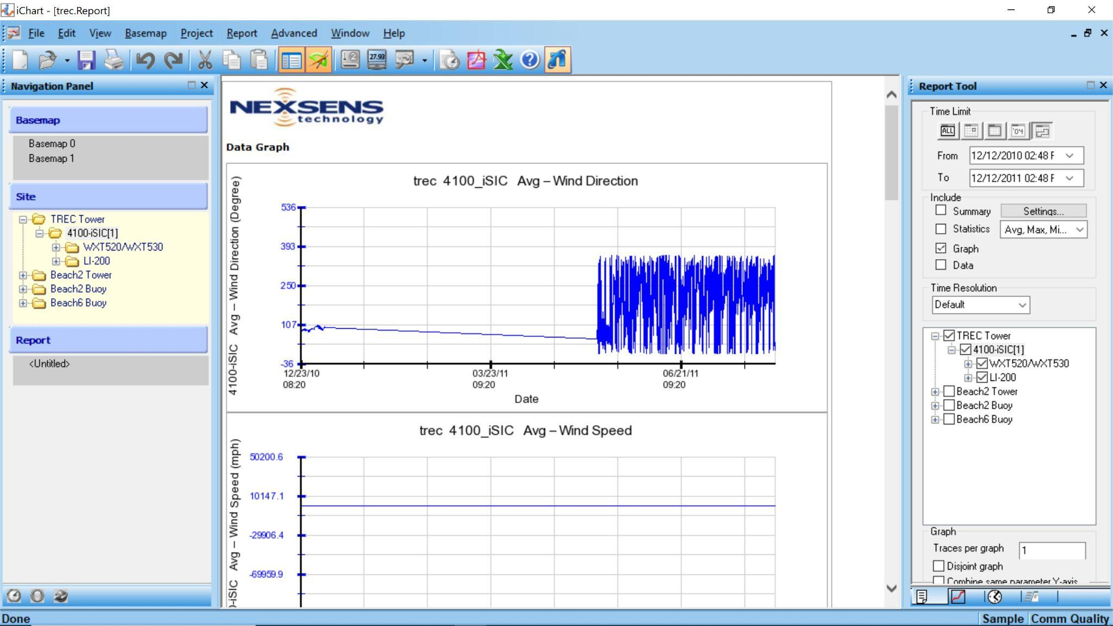
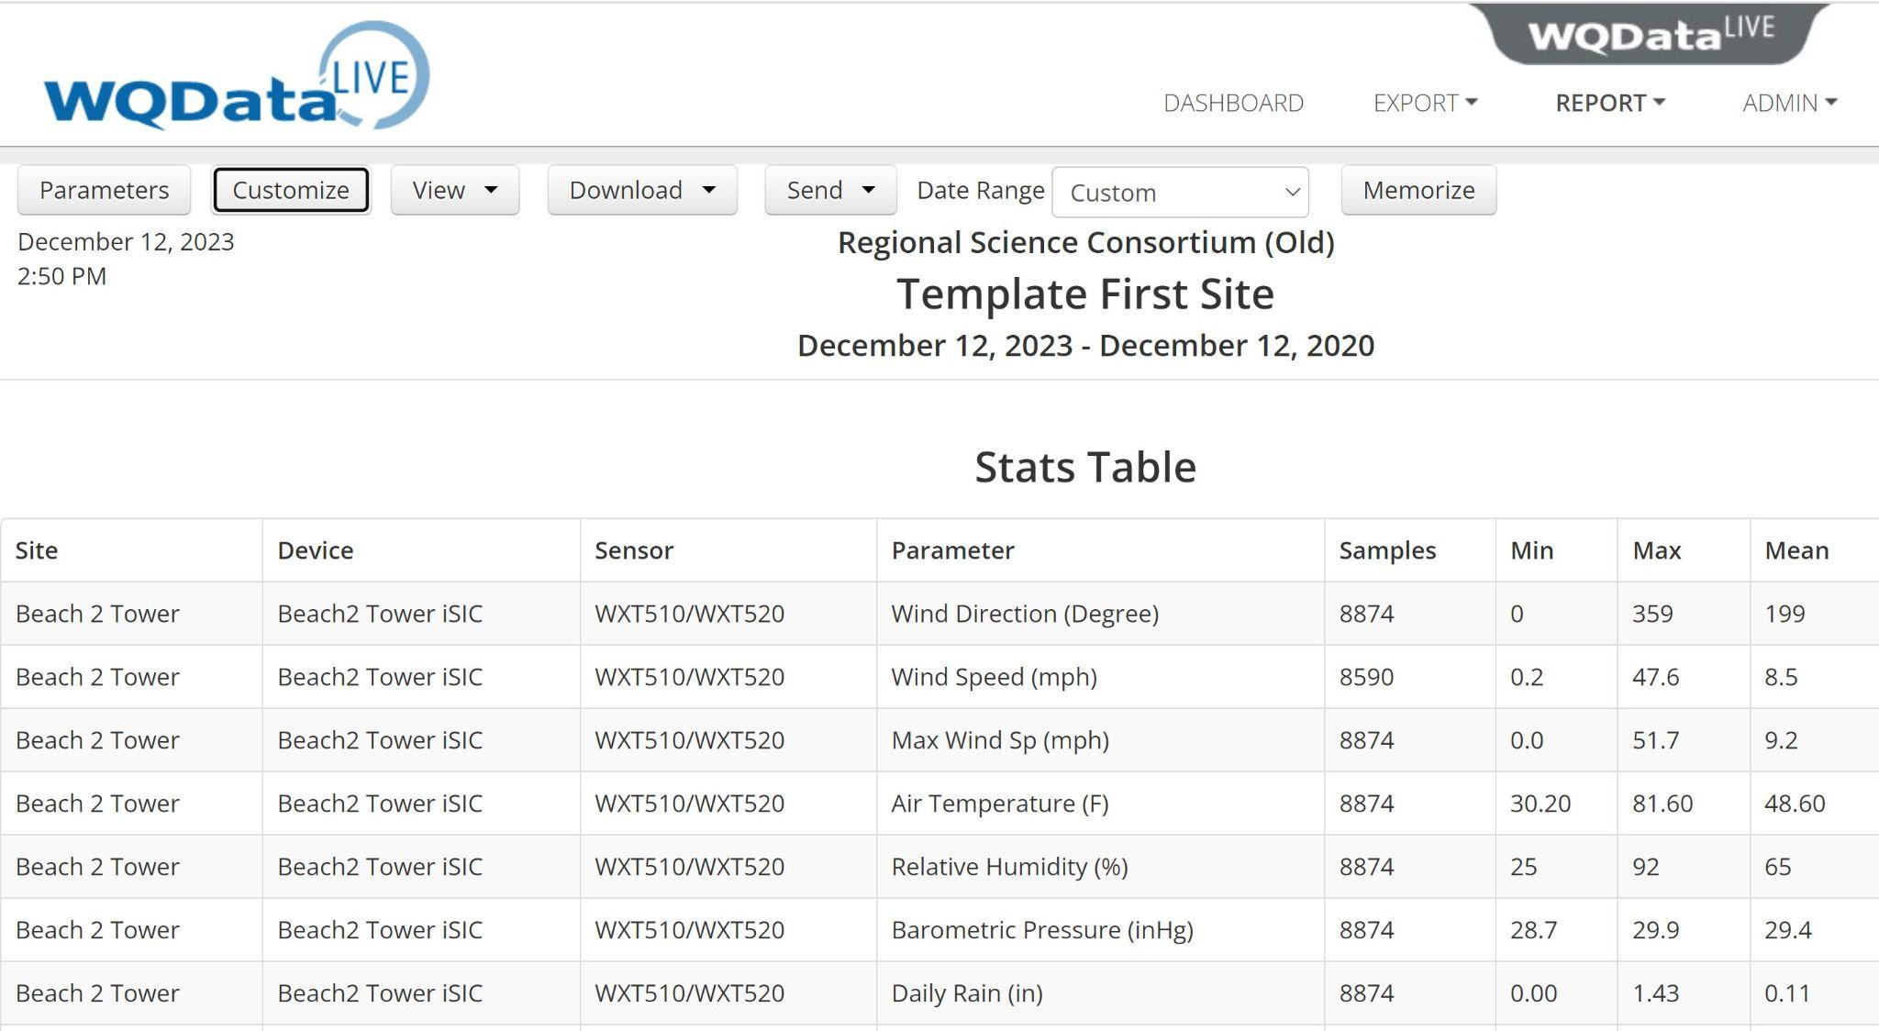
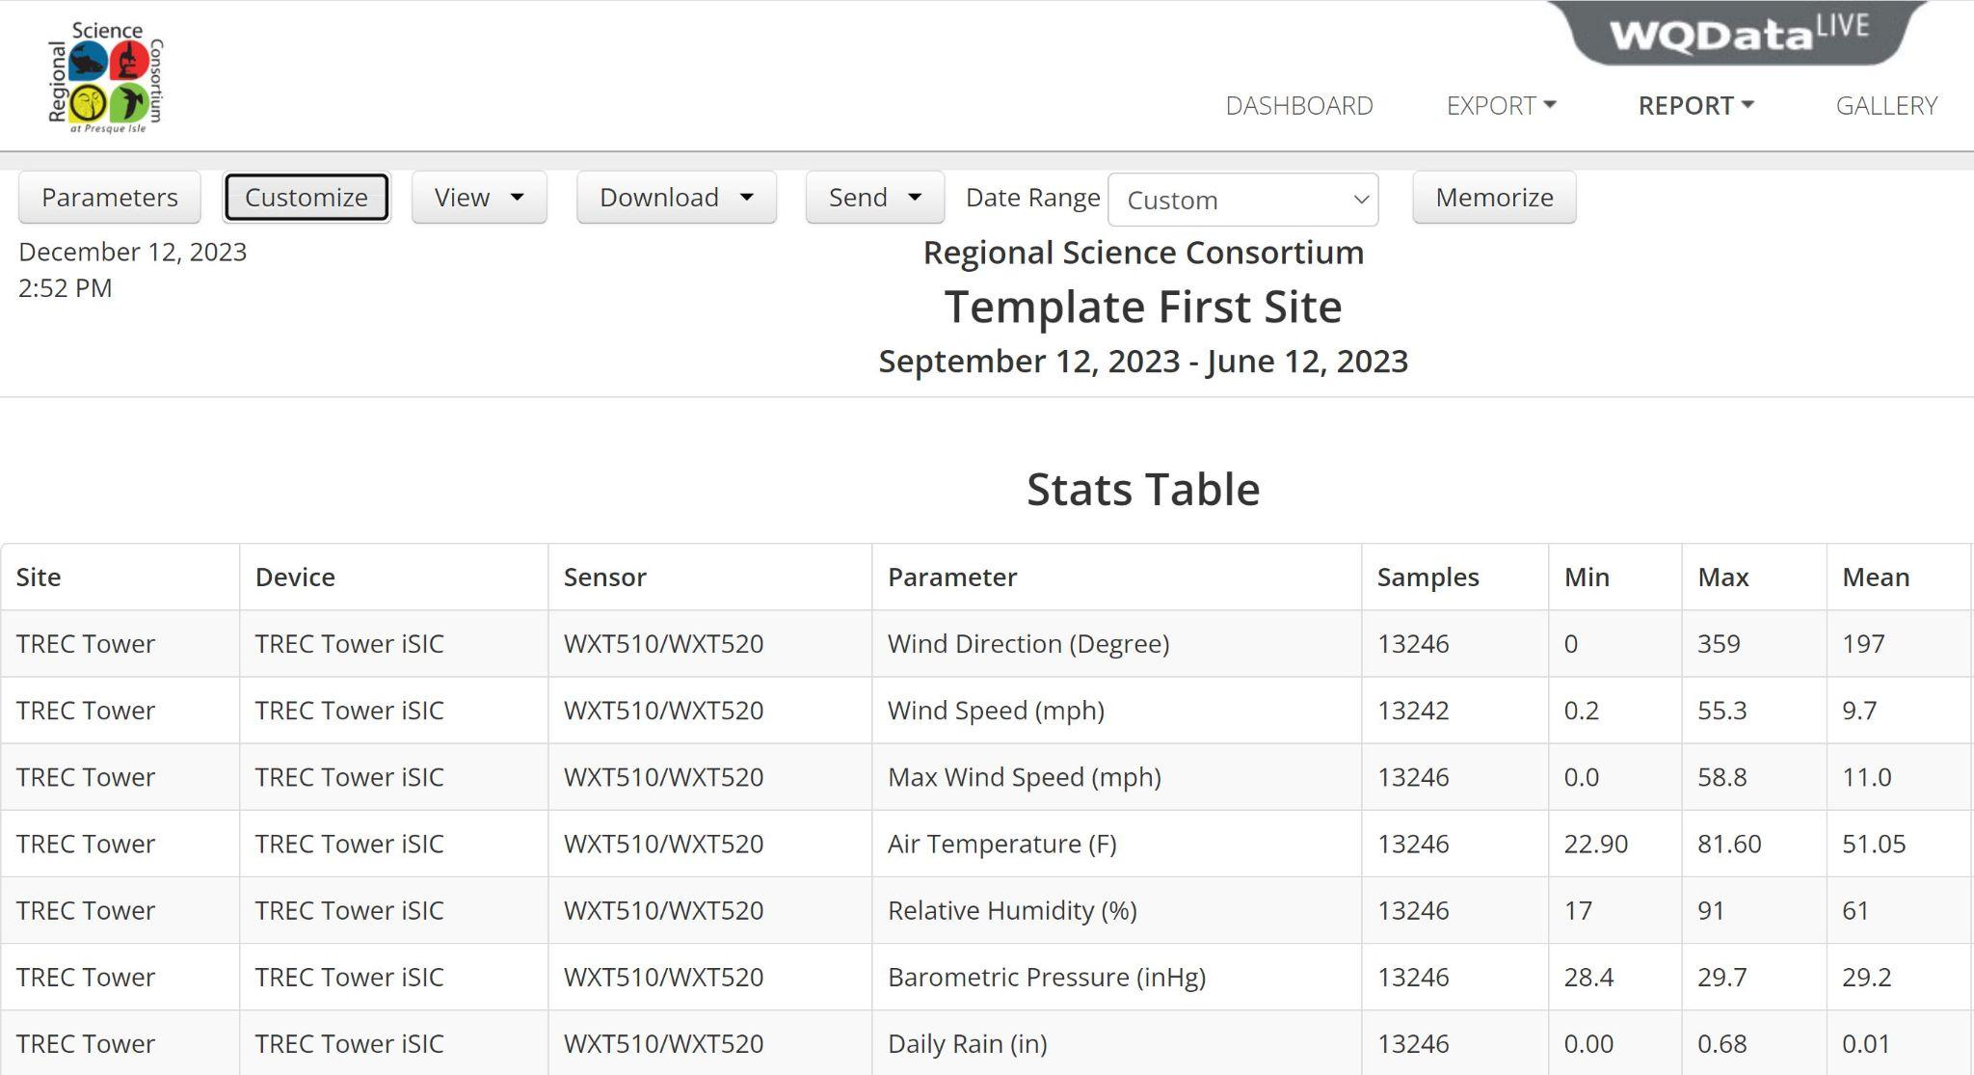
Data Wrangling Across 3 Projects/Sources
iChart6 circa 2002
Google drive raw ichart files
Manually download 6 years worth of data
Reminded me of childhood computers
WQData Live
“Old” and “new” project data
Can download via API calls
Questionable API set up
Reminded me of papercuts

Slide 7
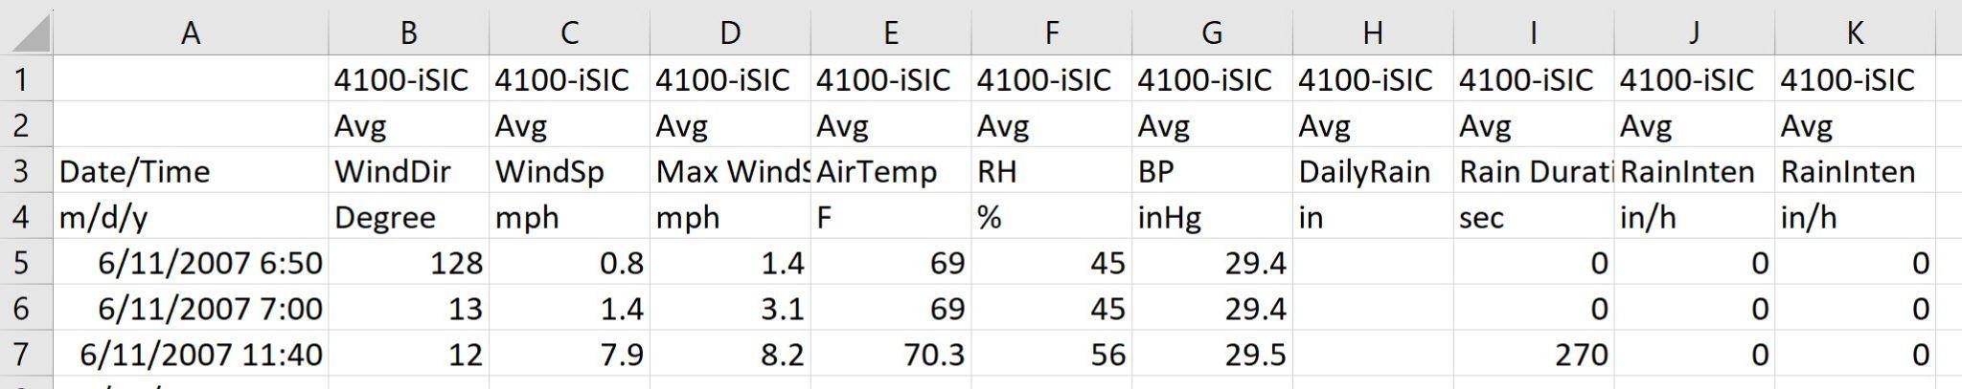
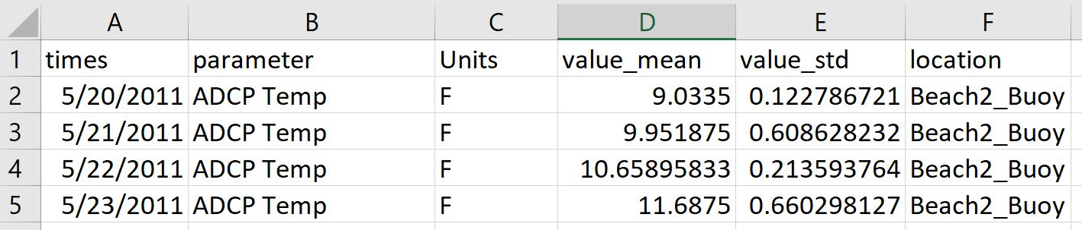
Data Conversion
Example iChart Data
Standardized…
To tidy format
Device names
Parameter names
Units
Down-sampled data frequency
hourly
daily
All parameters across all years are now combined into 1 file,
as opposed to 20 files per year,
across 3 different data sources.
Example Cleaned Data

Slide 8
Project Design - Front End
Filtering and processing of cleaned data-set, GUI
Database Manipulator
Filters larger dataset down to user-selected values
Plotting Functions
Plot created datasets such that graphs displayed correctly
Advanced Statistics
Utilize Database Manipulator to generate plots and advanced stats

Slide 9
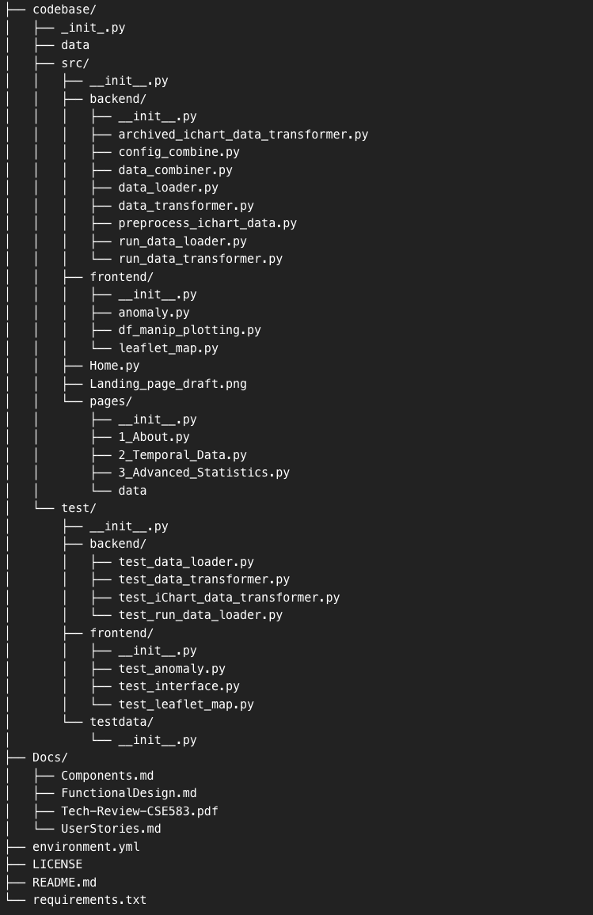
Project Structure
Clear differentiation between subsystems

Slide 10
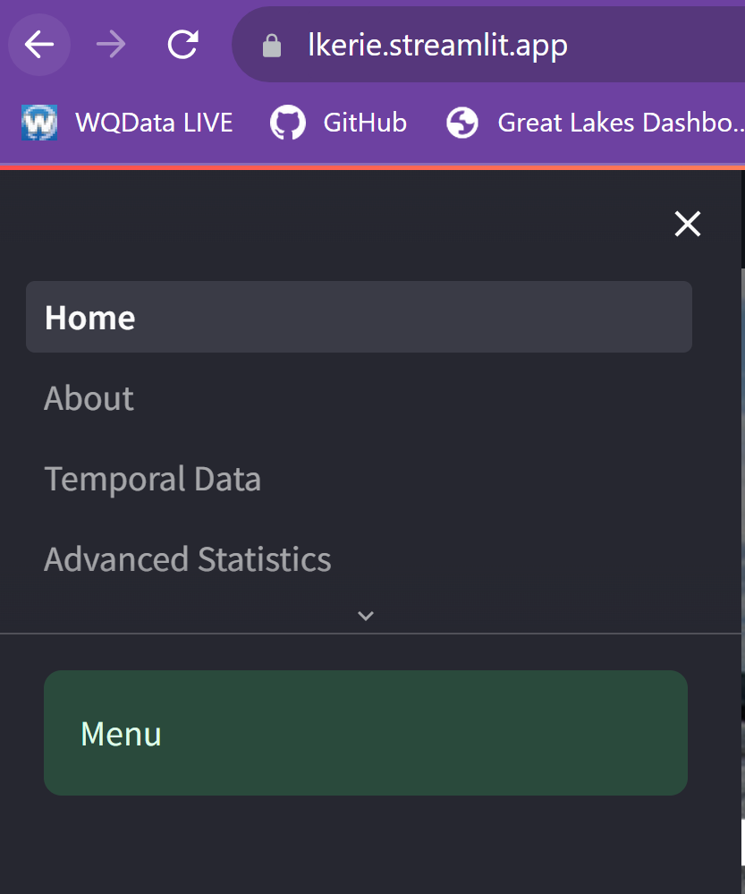
The Streamlit App
Portal to the clean, organized data
Use-cases:
Scientific Research
Fishing Insight

Slide 11
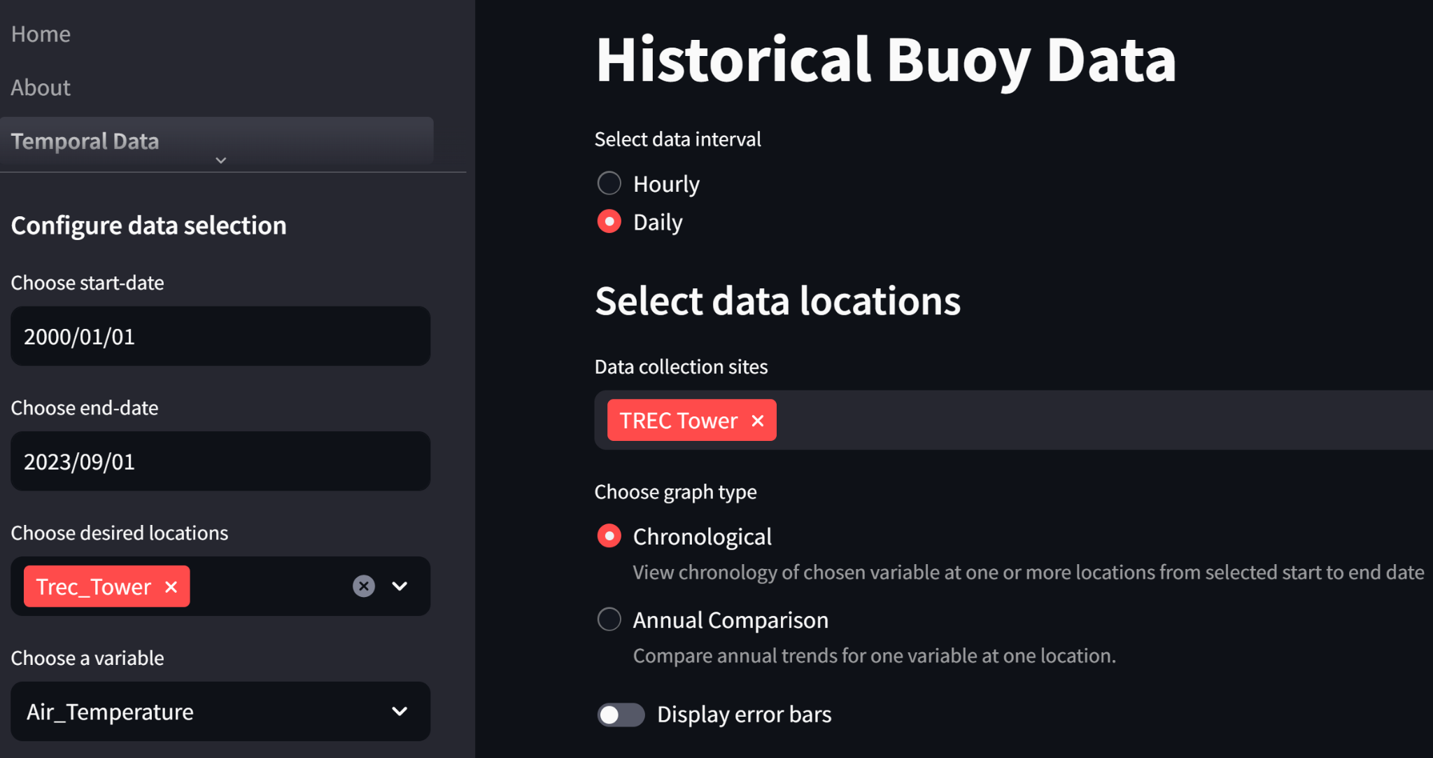
Temporal History
A General Overview of Data
Users filter data based on
Location
Time period
Time interval
Parameter
Available plots include
Chronological
Annual Comparison
Customization
Toggle error bars
Adjust plot height, width
Export
png of plot
.csv of plotted data

Slide 12
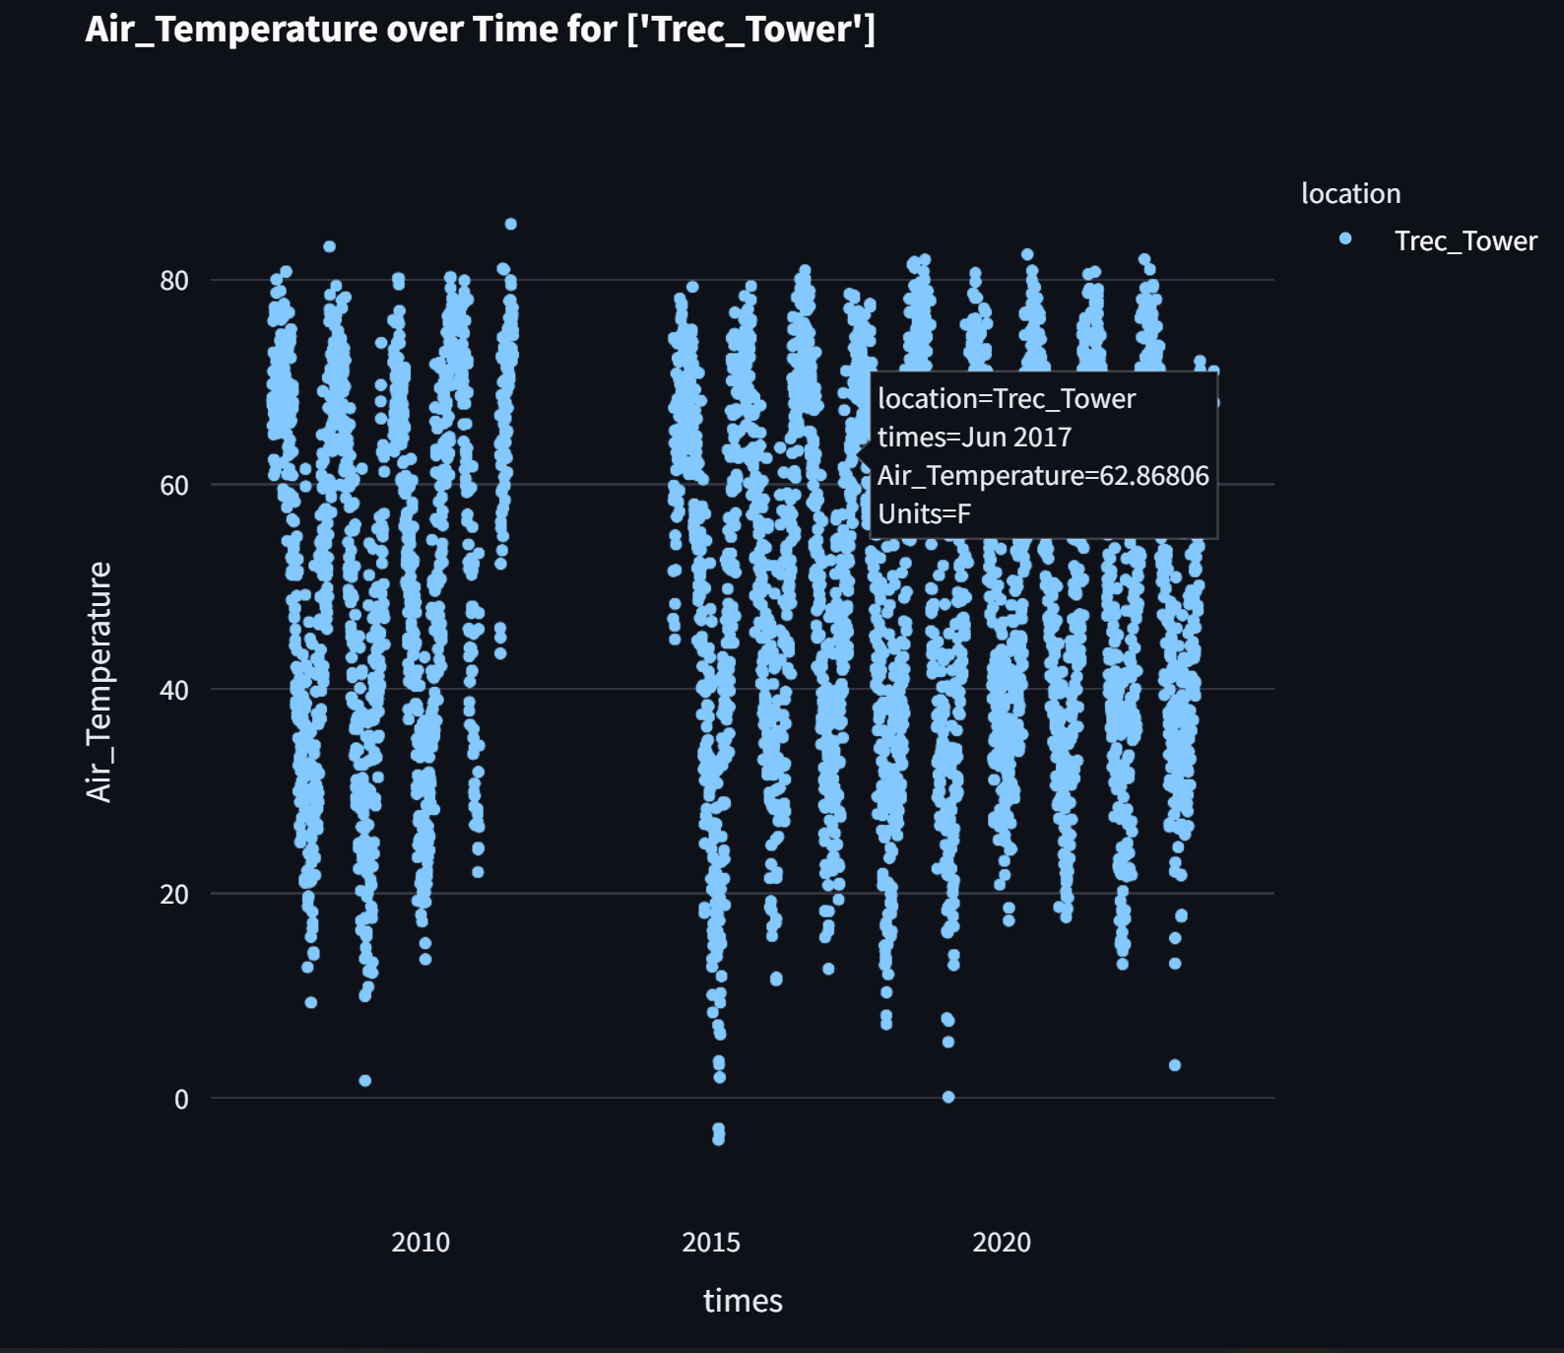
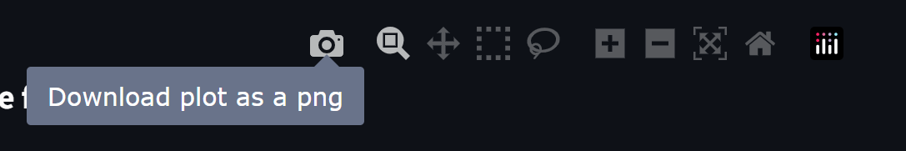
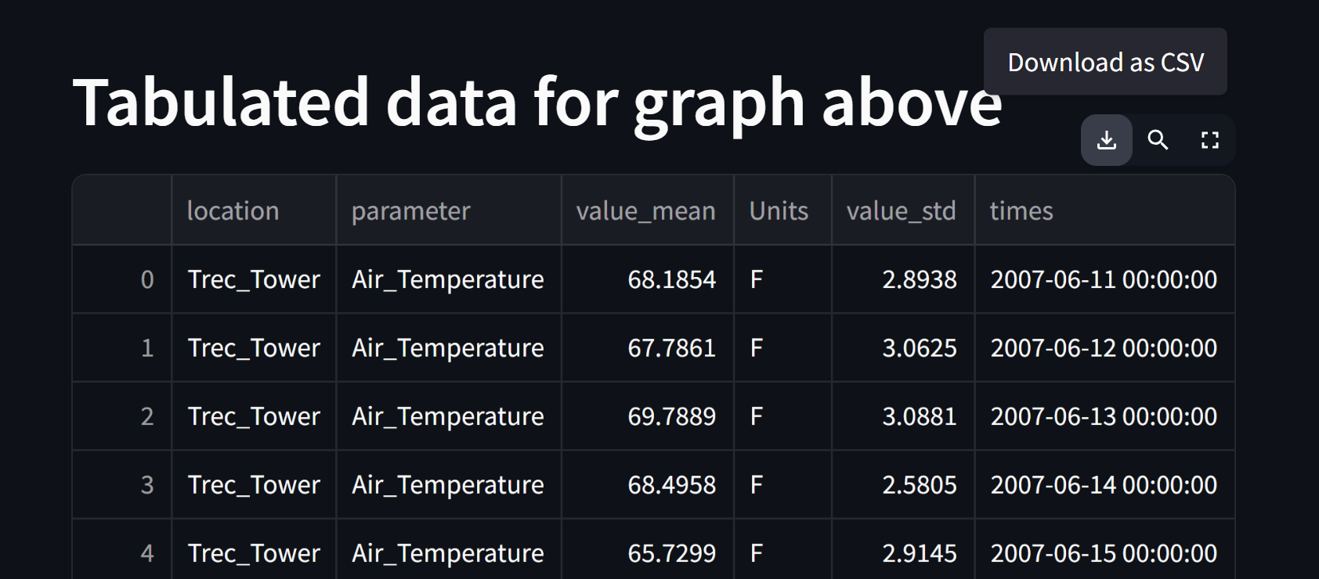
Chronological Plot

Slide 13
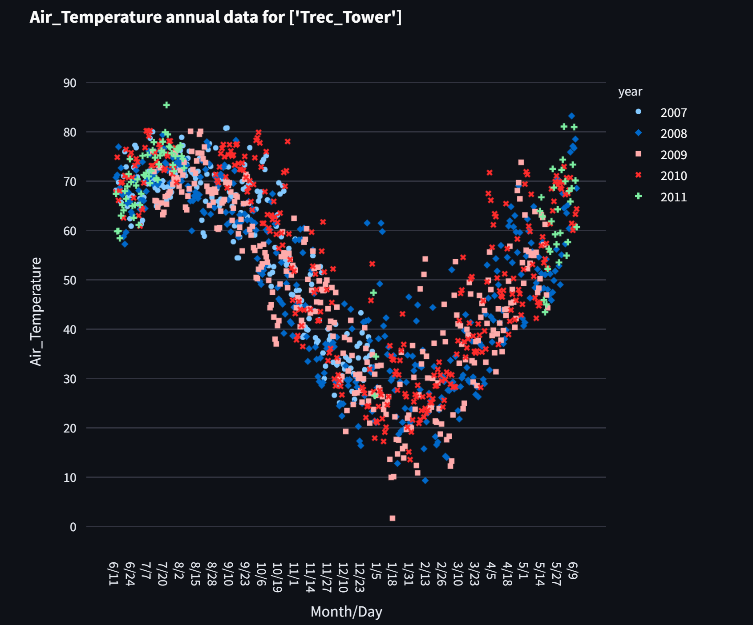
Annual Comparison Plot

Slide 14
Advanced Data Analytics
Pulling out patterns in the data relevant to scientists
It may be useful for scientists to visualize how long term trends change over time, and to have a tool to help find data points to further explore in a large dataset

Slide 15
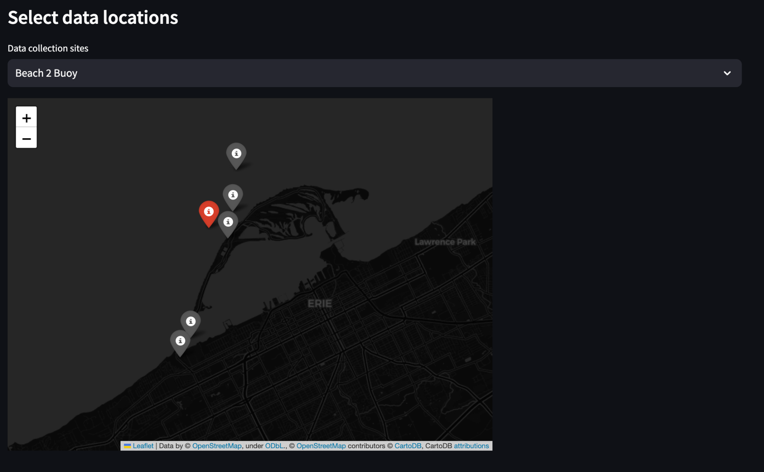
Visualize Time series data with a trend
Explore locations using dynamic map
Select location of interest
Icon turns red

Slide 16
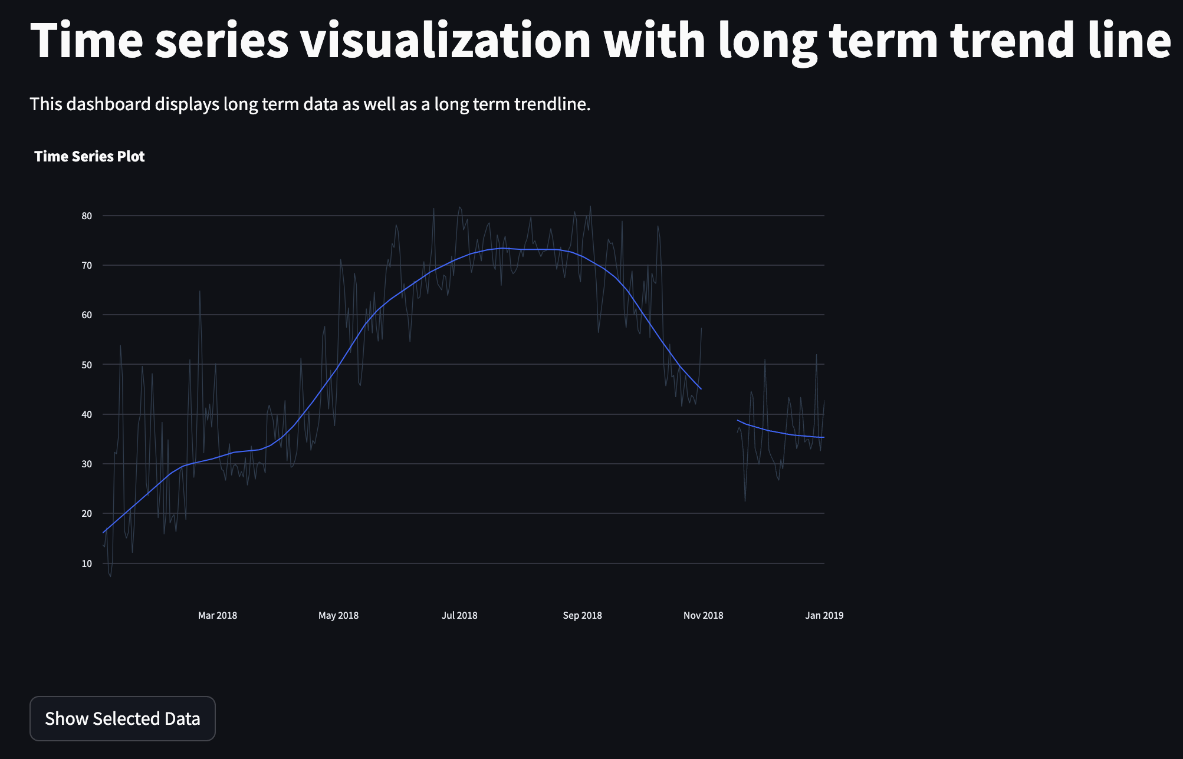
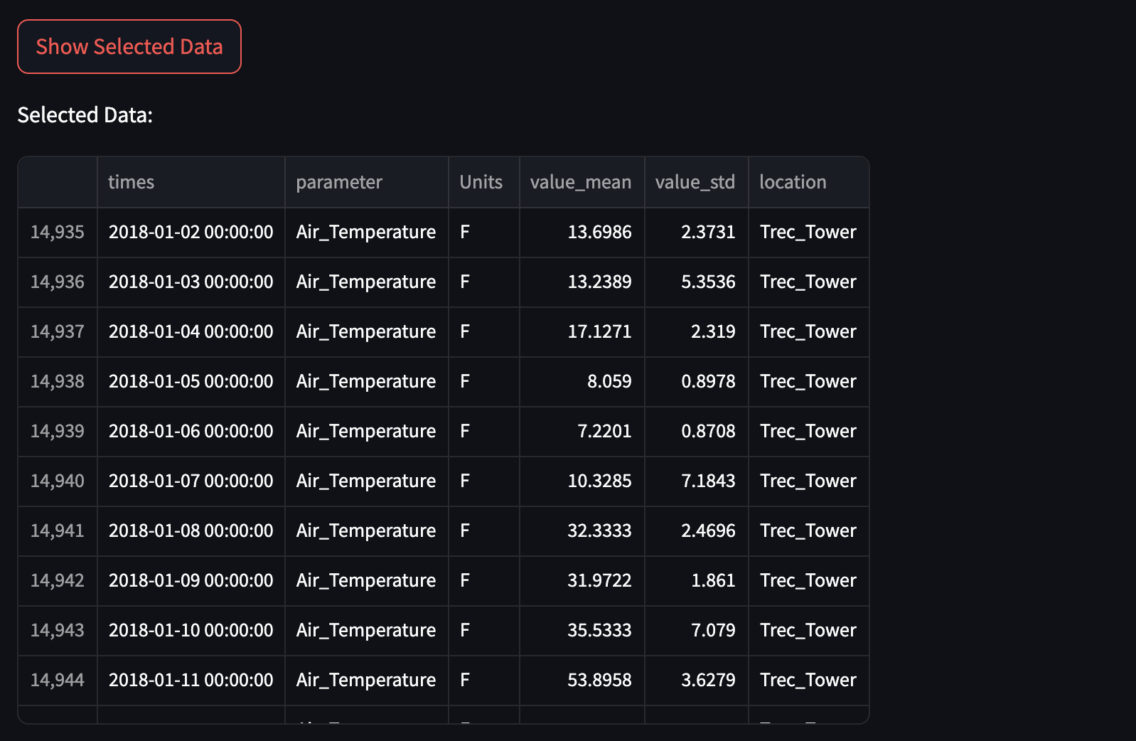
Visualize time series data with a trend

Slide 17
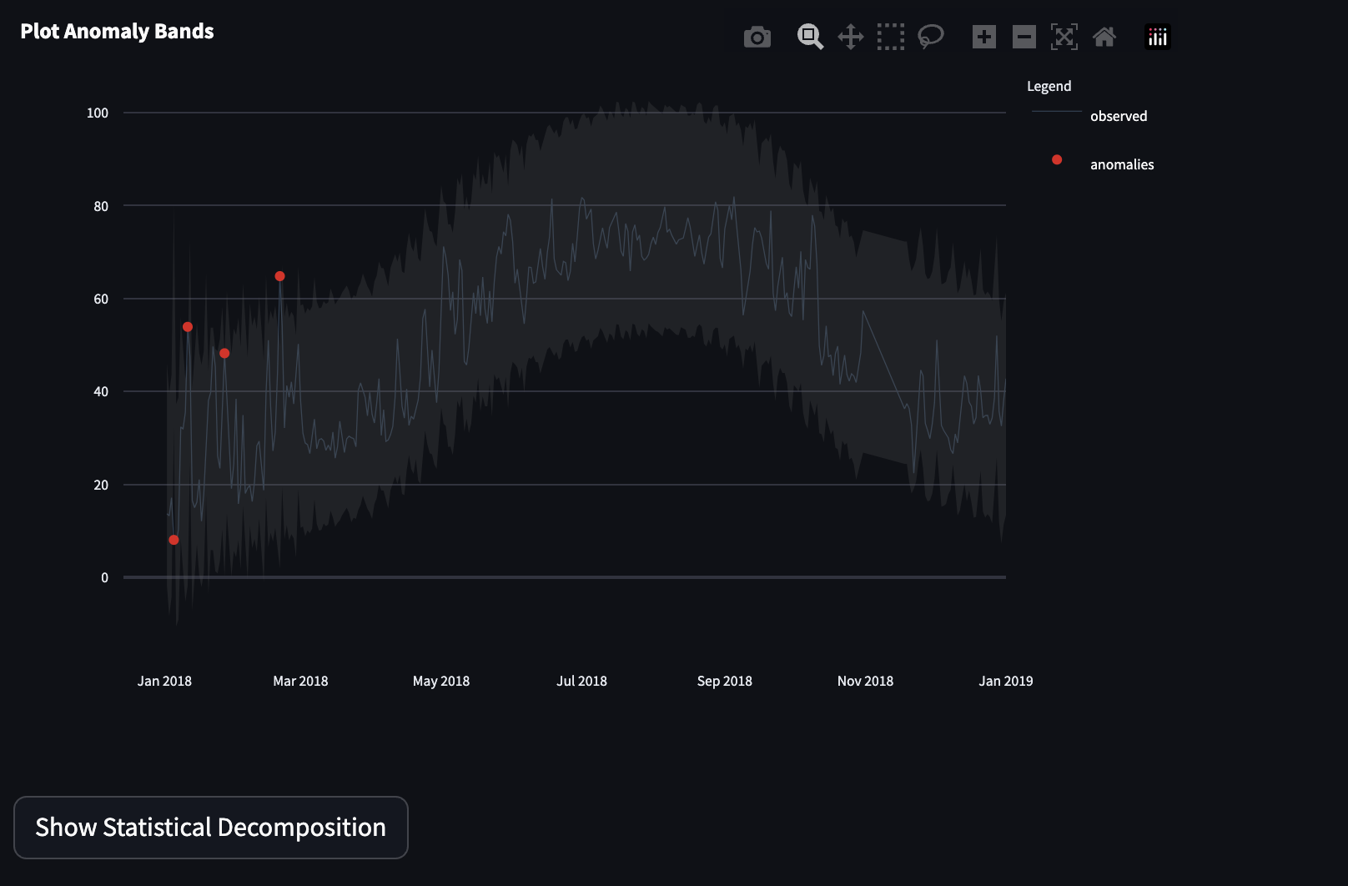
Exploring Anomalies in the data
User defined preferences for…
Period: Window of seasonality to explore.
IQR_alpha: Calibrates model sensitivity to detecting outliers
Performs statistical decomposition
Visualizes time series data
Flags…
Anomaly bands
Values marked as anomalies
User can hover to inspect
V2: clearly lay these values out for export or further exploration

Slide 18
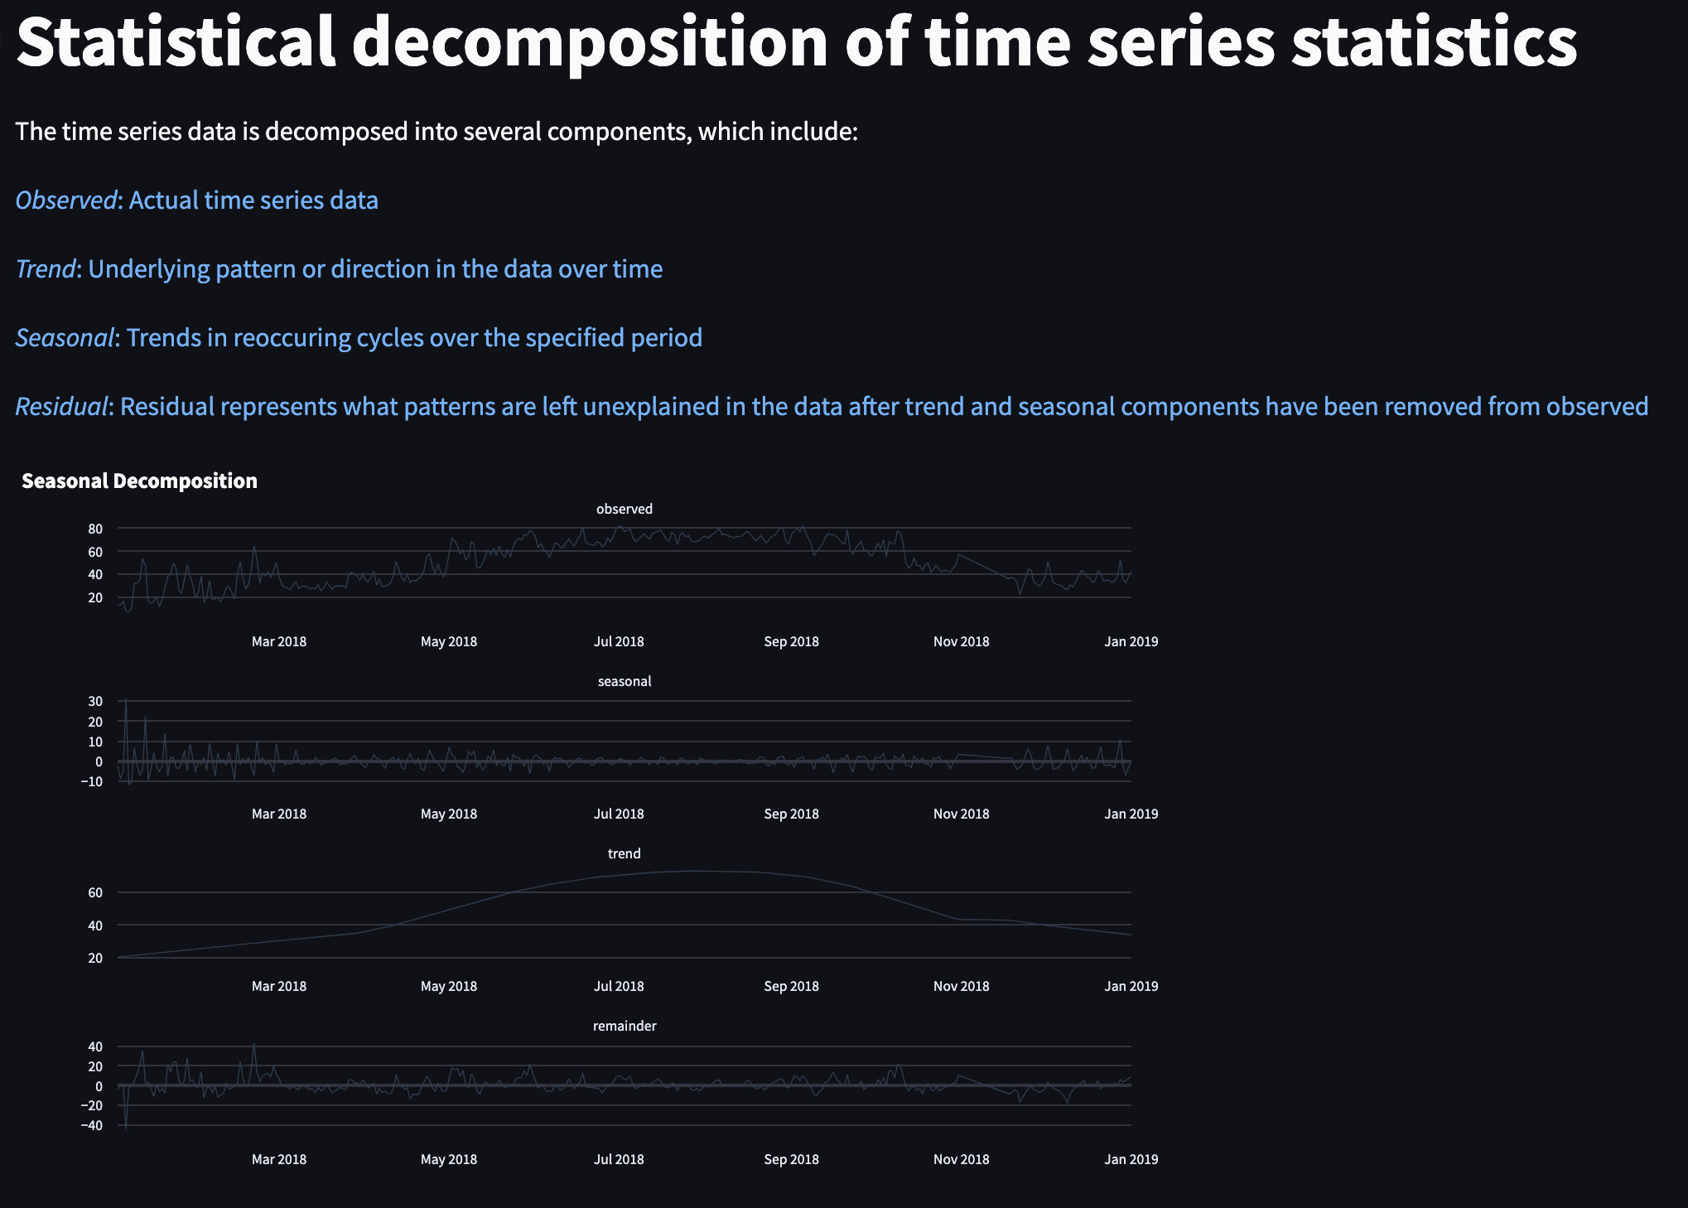
Deconstruction of Time Series Statistics,
Anomaly Calculation
“Show Statistical Decomposition”
button shows:
Observed data
Seasonality in the data
Trends in recurrent cycles
Overall trends
Residual: patterns left unexplained by long term or seasonal trends.

Slide 19
Lessons Learned
Directory structure is important
Critical details are not always included in the docs
Design GUIs to most optimally utilize test-driven development

Slide 20
Future Work - V2.0
Live Data collection
Parameter additions
Bug fixes

Slide 21
Acknowledgements
Dr. Jeanette Schnars - RSC Contact
Justin Walters and Joseph Davidson - WQData Live POC’s
Dave, the man, Beck - Guidance, Support, Inspiration
Nels Schimek - Streamlit Assistance
Evan Komp - Python/Github Support
Stack Overflow - Team MVP

Slide 22
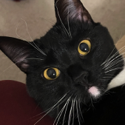
Questions?

